Slide 1

Real-Time Translation Tool for cPort Credit Union
Bridging Language Barriers in Community Banking
Presenter: Yuan
Date: August 27, 2025

Slide 2

Outline
Background
Tech Solution
AI Fine-tuning details
Concern
Timeline
Budget
Expectation
Demo
QA

Slide 3
Our Vision: Personalized Multilingual Banking for Maine
The Challenge:
The Solution:
The Impact:
56,500+ immigrants in Maine need banking services but face language barriers
AI-powered real-time translation tool with human-in-the-loop approach
15-25% increase in immigrant member acquisition within 12 months
The Investment:
The Timeline:
$40-50K total first-year cost with $575-775/month operational expense
4-month development, January 2025 pilot launch
Bottom Line: Transform cPort into Maine's premier multilingual financial institution while maintaining the personal touch that defines credit union banking

Slide 4
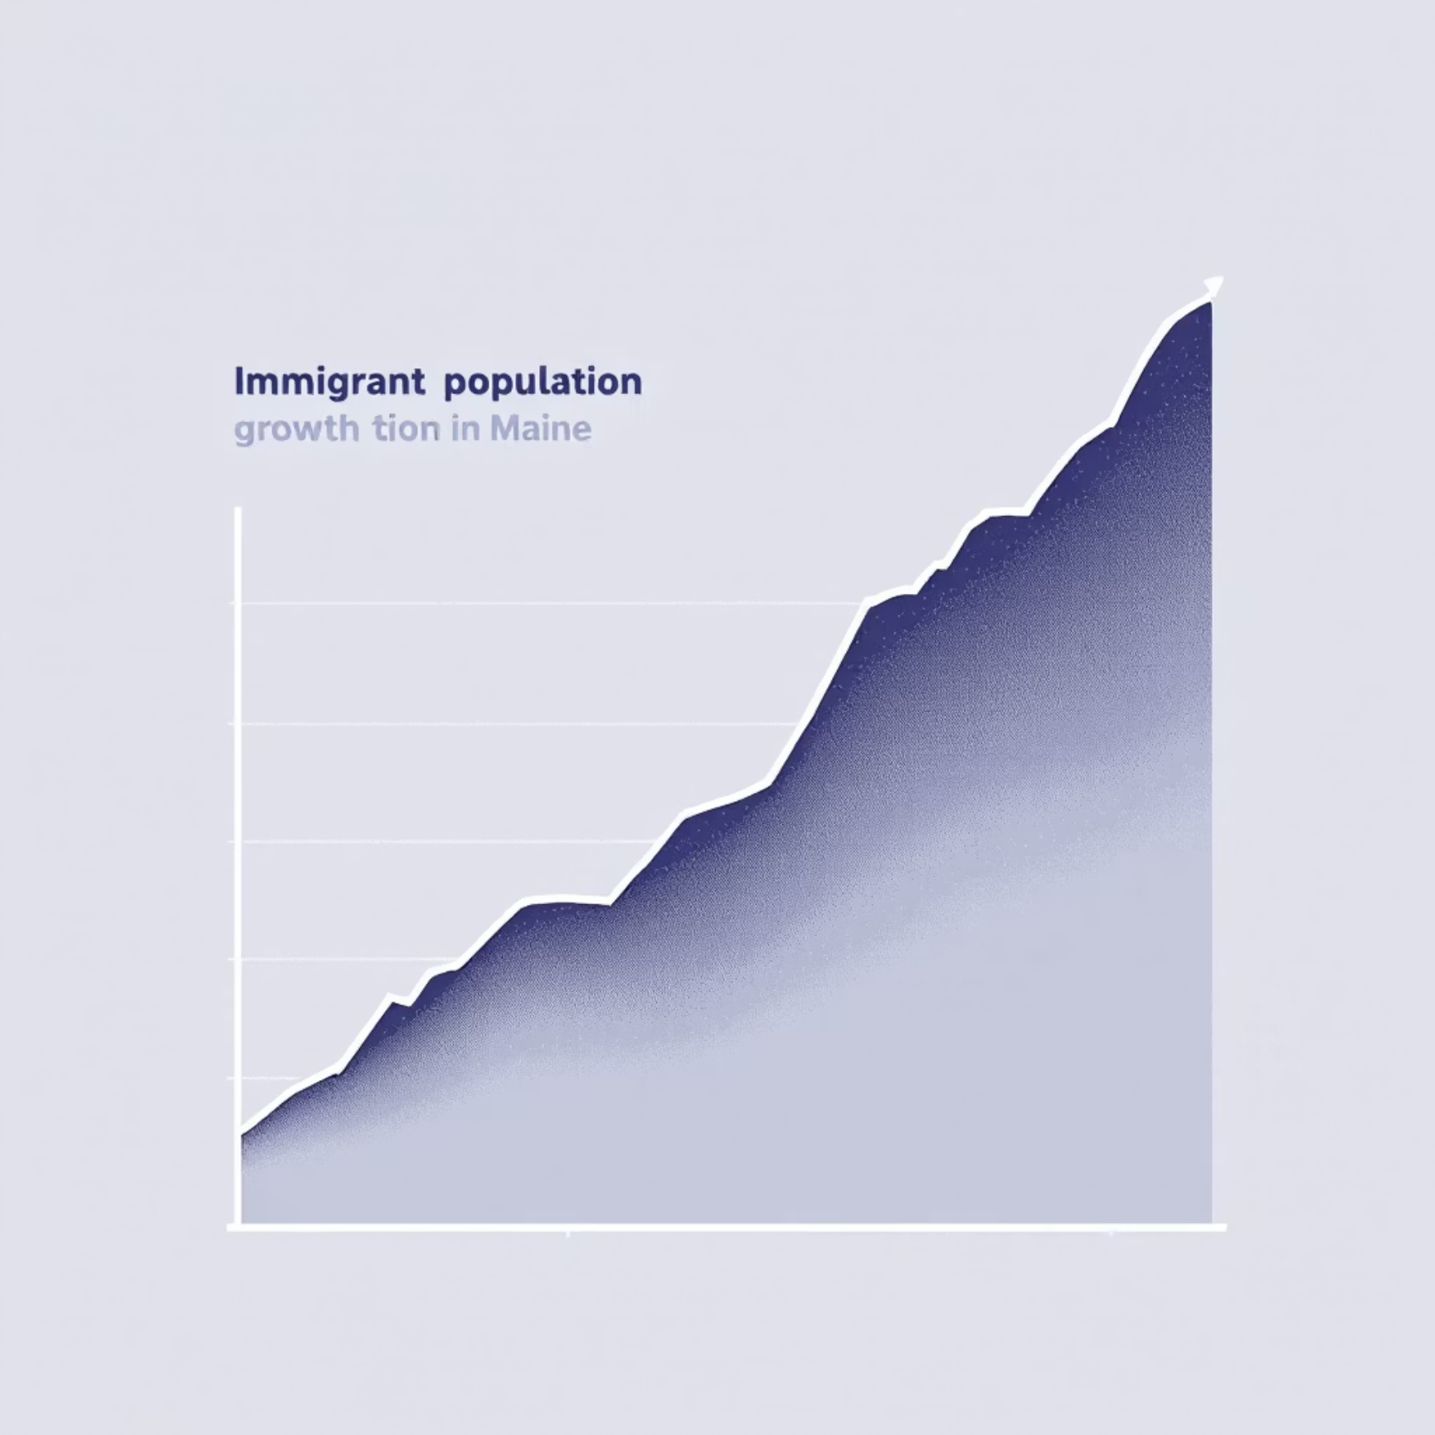
Why Now? The Urgent Need for Multilingual Banking
Current Pain Points:
Service Delays: 30-40% longer transaction times for non-English speakers
Lost Opportunities: Unable to serve 56,500+ potential members effectively
Competitive Pressure: Large banks offering digital multilingual services
Staff Frustration: Communication barriers affecting employee satisfaction
Compliance Risks: Financial disclosures in English-only create liability
Critical Insight: "Maine's immigrant population is growing 3x faster than general population - this is not just a service improvement, it's a strategic necessity for growth"

Slide 5
Serving Maine's Diverse Communities
Priority Languages & Populations:
Unique Credit Union Context:
Portuguese (1,600+): Angolan community with Kimbundu influences
"Share draft accounts" vs. checking accounts
"Members" not customers
French (39,000+): Congolese using Belgian French with Lingala
Cooperative financial concepts need cultural translation
Somali (2,400+): Including Somali Bantu variations
Community Partnerships:
Arabic (1,500+): Multiple regional dialects
Spanish (14,000+): Diverse Latin American origins
Greater Portland Immigrant Welcome Center
Maine Immigrants' Rights Coalition

Slide 6
Smart, Simple, Scalable: Our Technical Approach
Three-Layer Architecture:
1. User Interface Layer
Greeter iPad app (React PWA)
1
Teller desktop interface
Consultor extended session tools
Real-time WebSocket updates
2. Processing Layer
Node.js/Express backend
2
PostgreSQL database
Session management
Queue orchestration
3. AI Services Layer
Google Cloud Translation with AutoML (primary)
3
OpenAI Whisper (audio processing)
Hume AI (emotion detection)
Custom banking terminology models
Key Design Decision: Standalone system - no complex banking system integration required

Slide 7

Human-First, AI-Powered Service Flow
Step-by-Step Process:
01
02
Welcome (0-30 seconds)
Understand (30-90 seconds)
Greeter identifies language need
Real-time audio translation
One-tap language selection
AI categorizes service need
AI begins listening
Emotion detection for urgency
03
04
Route (90-120 seconds)
Handoff (Seamless)
AI recommends service type
Full context transferred to banker
Greeter assigns to appropriate queue
Translation continues throughout service
Context captured automatically
Session summary in customer's language
Success Metric: <2 minute average greeter interaction

Slide 8
Built for Success: Feasibility Analysis
Technical Feasibility:
Operational Feasibility:
Financial Feasibility:
Proven Technologies: Google Cloud Translation API (99.9% uptime), React, Node.js
Minimal Training: <2 hours per staff member
Low Initial Investment: $40-50K total (vs. $200K+ for enterprise solutions)
Device Compatibility: Works on existing iPads and desktops
Simple Architecture: No complex integrations, standalone operation
Predictable Costs: $575-775/month operational expenses
Gradual Rollout: Pilot at one branch, then expand
Quick ROI: Break-even at 50 new members ($10K average deposits)
Managed Services: Cloud-based APIs reduce maintenance burden
Progressive Development: 4-month phased approach with clear milestones

Slide 9
Built to Last: Long-Term Sustainability
Technical Sustainability:
Operational Sustainability:
Financial Sustainability:
Cloud-Native: Automatic scaling, no hardware maintenance
Community Validation: Ongoing partnerships ensure cultural accuracy
Usage-Based Pricing: Costs scale with actual usage
API-Based: Updates handled by service providers
Revenue Generation: Enables new member acquisition
Staff Adoption: Designed with staff input, addresses real pain points
Simple Codebase: Maintainable by junior developers
Grant Eligibility: Qualifies for financial inclusion grants
Documentation: Complete handoff package for cPort IT
Performance Monitoring: Built-in analytics for continuous improvement
Automated Backups: Daily backups, disaster recovery built-in

Slide 10
Honest Assessment: Trade-Offs We're Making
1
2
Trade-Off 1: Accuracy vs. Speed
Trade-Off 2: Features vs. Timeline
Choice: 85% accuracy with 2-second response vs. 95% with 10 seconds
Choice: MVP in 4 months vs. full features in 12 months
Mitigation: Phased rollout, core features first, continuous improvement
Mitigation: Staff oversight, confidence scoring, easy correction tools
3
4
Trade-Off 3: Cost vs. Customization
Trade-Off 4: Integration vs. Simplicity
Choice: $50K with Google Cloud vs. $500K custom solution
Choice: Standalone system vs. core banking integration
Mitigation: Fine-tuning models for banking terms, community validation
Mitigation: Manual processes acceptable, future integration possible
Key Insight: "Perfect is the enemy of good - we need a solution now, not a perfect solution never"

Slide 11
Smart AI Implementation: Custom Models for Banking
Three-Tier Translation Approach:
Audio Processing Strategy:
Custom Banking Models (Primary)
OpenAI Whisper for complex audio
Fine-tuned on cPort documents
Whisper for STT
Credit union terminology
GPT 4 or 5 Translation (Banking prompt + tone)
OpenAI for TTS synthesis
95% accuracy for banking terms
Google Cloud Translation (Fallback)
Emotion Detection (Hume AI):
General translation capability
Identify frustration/confusion
85% accuracy baseline
Alert staff to provide extra help
Always available
Improve service quality
Community Validation (Quality)
Native speaker review
Cultural appropriateness
Continuous improvement

Slide 12
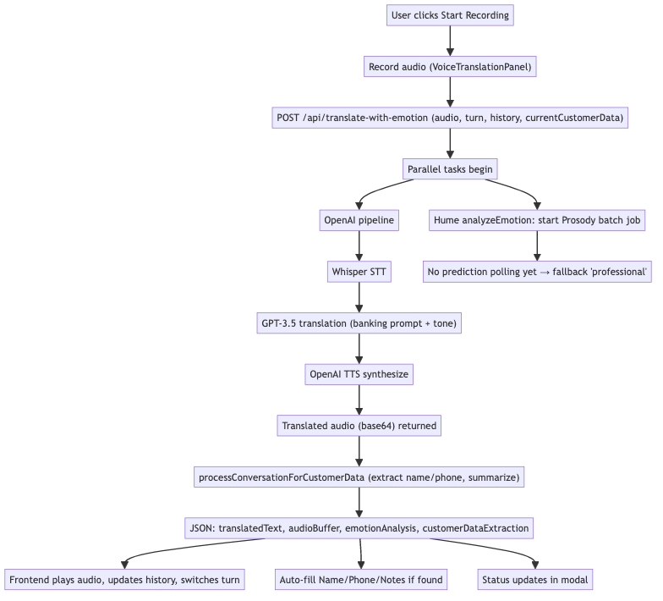
TRANSLATION WORKFLOW

Slide 13
Proactive Risk Management
1. Translation Errors (Financial Liability)
2. System Downtime (Service Disruption)
Staff verification required
95% uptime SLA
Confidence scoring visible
Fallback to manual process
Audit trail for compliance
Cellular backup internet
3. Community Resistance (Adoption)
4. Regulatory Concerns (Compliance)
Community leader involvement
Complete documentation
Gradual rollout
NCUA communication plan
Cultural sensitivity training
Regular compliance audits
Success Factor: Multiple fallback options ensure service continuity

Slide 14
Clear Path to Success: 4-Month Sprint
01
02
Month 1 (September 2025): Foundation
Month 2 (October 2025): Core Features
Week 1-2: Environment setup, API integration
Week 1-2: Greeter interface, queue management
Week 3-4: Database design, basic UI framework
Week 3-4: Teller interface, session handling
Milestone: Working translation prototype
Milestone: End-to-end workflow complete
03
04
Month 3 (November 2025): Enhancement
Month 4 (December 2025): Launch Prep
Week 1-2: AI model training, banking terms
Week 1-2: Testing, bug fixes, optimization
Week 3-4: Consultor features, document handling
Week 3-4: Staff training, documentation
Milestone: Feature-complete beta
Milestone: Production-ready system
January 2025: Pilot launch at Forest Avenue branch

Slide 15
Smart Investment: Maximum Impact, Minimum Cost
Development Costs (One-Time): $25,000
Annual Operating Costs: $15,000
Developer (160 hours @ $100/hr): $16,000
Google Cloud Translation: $4,800
UI/UX Design: $3,000
OpenAI Whisper: $1,200
Testing & Validation: $3,000
VPS Hosting: $1,440
Documentation & Training: $3,000
Custom Model Training: $1,800
Infrastructure Setup: $5,000
Maintenance & Updates: $5,760
VPS Server Setup: $2,000
SSL Certificates & Domain: $500
Development Tools: $1,500
Backup Systems: $1,000
Total First Year: $45,000 Monthly Operating: $775
ROI Calculation: 50 new members × $10K deposits × 2% margin = $10K annual revenue

Slide 16
Measurable Results: ROI Within 6 Months
Member Acquisition:
Customer Experience:
Target: 500+ new immigrant members
20-point increase in satisfaction scores
Average deposit: $10,000
10-point increase in Net Promoter Score
New deposits: $5 million
95% service completion rate
Operational Efficiency:
Market Position:
20% reduction in service time
First credit union in Maine with real-time translation
30% reduction in interpreter costs
Media coverage and industry recognition
15% improvement in staff satisfaction
Model for other credit unions
Financial Impact:
Break-even: Month 3 (50 new members)
Year 1 ROI: 300-500%
Revenue potential: $500K-1.5M

Slide 17








Why cPort Will Win: Our Unique Position
1. Community Trust
2. Credit Union Difference
94-year history in Maine
Member-owned cooperative
Forbes #1 credit union 3 years running
Community-focused mission
Deep community relationships
Lower fees than banks
3. First-Mover Advantage
4. Human + AI Approach
First in Maine with this technology
Technology enhances personal service
Set the standard for others
Staff remain central to experience
Build immigrant community loyalty
Cultural sensitivity built-in
Competitive Reality: Large banks have technology but lack community trust and personal service

Slide 18
Measuring Success: Clear, Achievable Goals
30-Day Metrics:
6-Month Metrics:
System uptime >95%
1,000+ members served
100+ translations completed
100+ new accounts opened
Staff adoption >80%
$500K+ new deposits
Zero critical errors
90% staff satisfaction
90-Day Metrics:
1-Year Goals:
500+ customer interactions
2,000+ members served
50+ new immigrant members
250+ new members acquired
<2 minute average service time
$2.5M new deposits
85% translation accuracy
Expansion to all branches
Tracking Dashboard: Real-time metrics visible to management

Slide 19
The Window of Opportunity
Market Timing:
Risk of Waiting:
Immigrant population growing rapidly
Lose first-mover advantage
Competitors haven't moved yet
Competitors capture market
Community trust at all-time high
Community needs unmet
Technology costs decreasing
Staff frustration grows
Organizational Readiness:
New Lewiston branch opening (high immigrant population)
Staff requesting better tools
Board supportive of innovation
Budget available
Critical Decision: Act now or cede the immigrant banking market to larger institutions

Slide 20


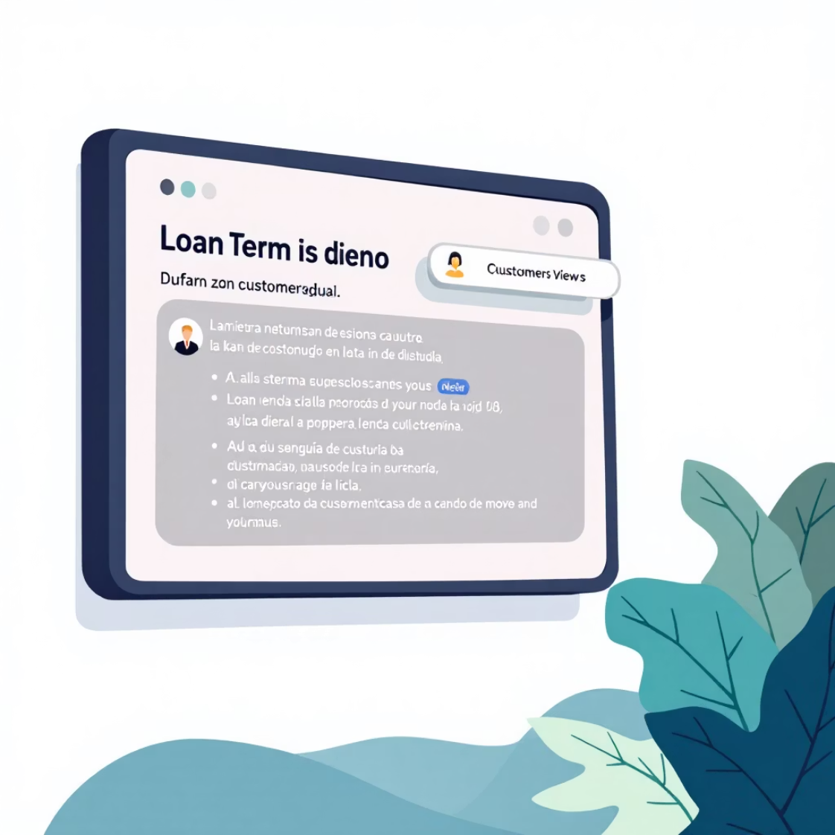
See It In Action: Live Demonstration
Demo Scenario: Portuguese-speaking customer needs auto loan
Screen 1: Greeter iPad
Screen 2: Consultor Desktop
Screen 3: Customer View
Language selection (Portuguese flag)
Full conversation history
Large text translations
Audio translation in progress
Document upload (loan application)
Loan terms explained in Portuguese
AI suggests "Complex Service - Loan"
Real-time translation during discussion
Visual confirmation of amounts
Queue assignment with one tap
Emotion indicator shows "anxious"
Session summary for take-home
Key Takeaway: Simple, intuitive, effective

Slide 21

Let's Build Maine's Future Together
Immediate Next Steps:
30-Day Milestones:
Approve budget allocation ($45,000)
Development environment ready
Assign project sponsor from executive team
First translation test complete
Identify pilot branch staff for testing
Staff feedback collected
Schedule community partner meetings
Community validation begun
Your Decision Today:
Approve project to begin September 1
Commit resources (budget + staff time)
Champion innovation at cPort
The Question: Will cPort lead the future of inclusive banking in Maine, or follow others?

Slide 22
Q&A Discussion
Key Topics for Discussion:
Commitment can be made:
Technical concerns or clarifications
Budget flexibility or phasing options
Future Staff training
Success metrics and accountability
Weekly progress updates
Monthly stakeholder reviews
Community-validated solution
Customer-centric implementation

Slide 23
SLIDE 20: Q&A and Discussion
Title: Your Questions, Our Commitment
Key Topics for Discussion:
Technical concerns or clarifications
Budget flexibility or phasing options
Staff training and change management
Community partner engagement
Regulatory compliance approach
Success metrics and accountability
Our Commitment:
Weekly progress updates
Monthly stakeholder reviews
Transparent issue escalation
Community-validated solution
Staff-centered implementation
Contact Information: [Project Manager Name & Email] [Technical Lead Name & Email]
Final Thought: "Technology is just a tool. In the hands of cPort's dedicated staff, it becomes a bridge to financial inclusion for all Mainers."

Slide 24
APPENDIX SLIDES (If Time Allows)
SLIDE A1: Technical Architecture Detail
Title: Under the Hood: Technical Components
Frontend Stack:
React 18.3 with TypeScript
Material-UI components
Socket.io client
Progressive Web App
Backend Stack:
Node.js 20.15 LTS
Express.js framework
PostgreSQL database
Prisma ORM
Infrastructure:
Ubuntu 22.04 VPS
NGINX reverse proxy
PM2 process manager
Let's Encrypt SSL

Slide 25
SLIDE A2: Community Validation Process
Title: Ensuring Cultural Appropriateness
Validation Partners:
Greater Portland Immigrant Welcome Center
Maine Immigrants' Rights Coalition
Community religious leaders
Cultural association representatives
Validation Process:
Weekly translation review sessions
Cultural context verification
Banking concept explanations
Feedback integration loop

Slide 26
SLIDE A3: Regulatory Compliance
Title: Meeting Banking Standards
Compliance Areas:
NCUA examination readiness
GLBA privacy requirements
ADA accessibility standards
Fair lending regulations
Documentation:
Complete audit trails
Translation accuracy logs
Staff action tracking
Customer consent records

